Slide 1
Logistic Regression
Presenter: Krish C Naik

Slide 2


Slide 3
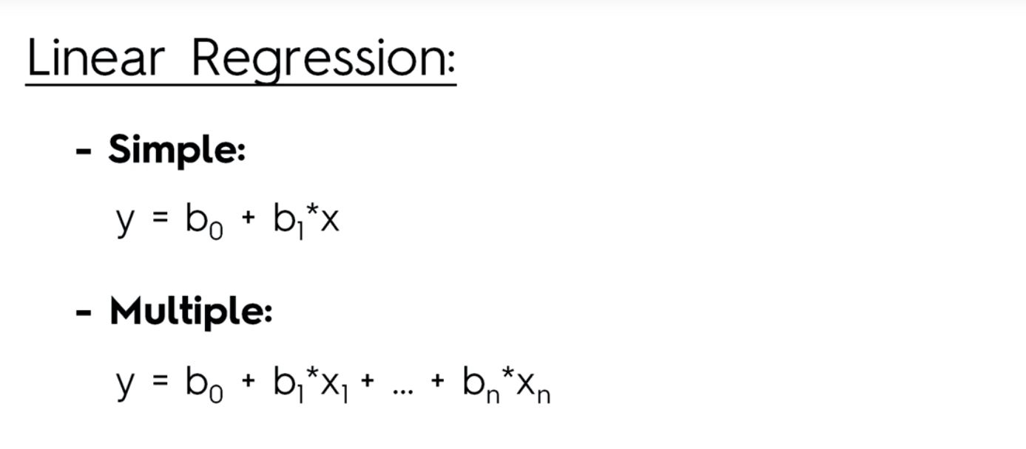
Logistic Regression

Slide 4
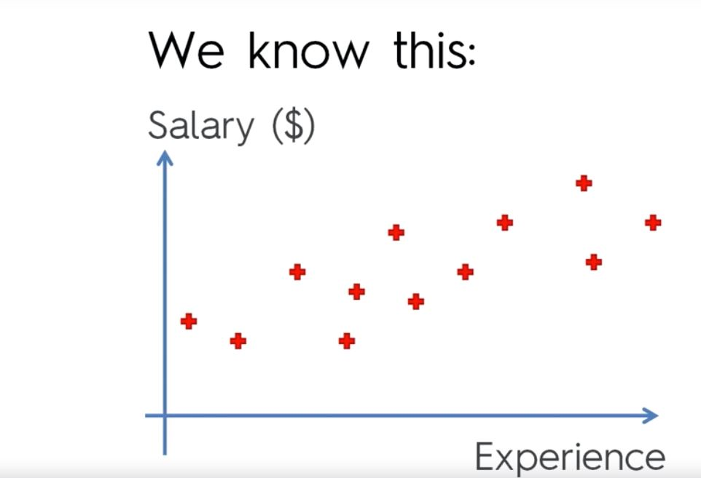
Logistic Regression

Slide 5
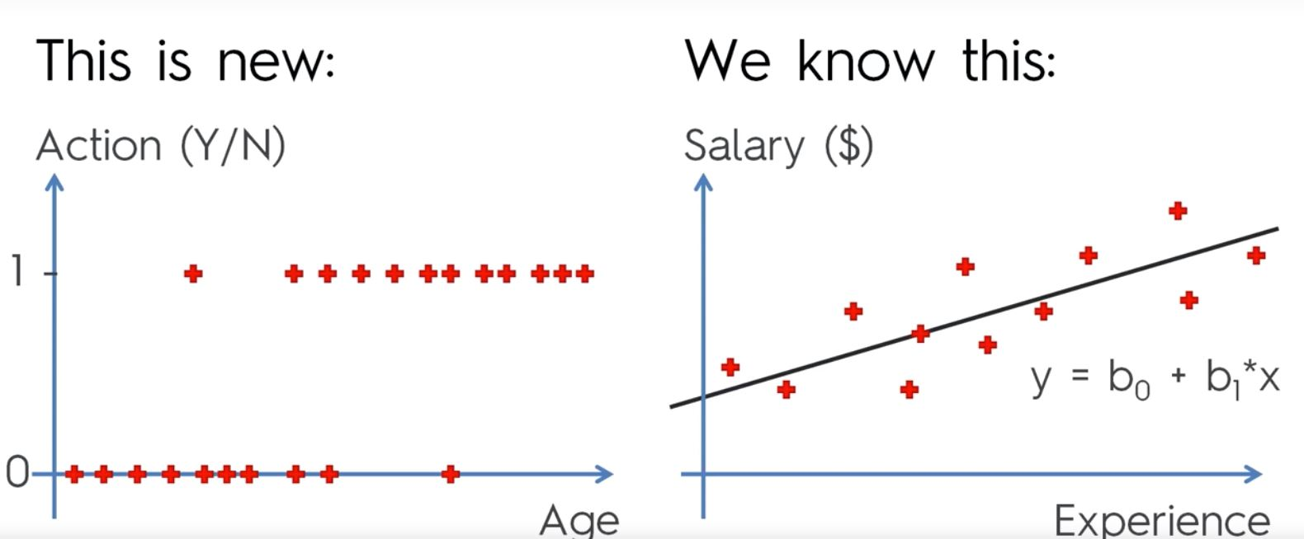
Logistic Regression

Slide 6
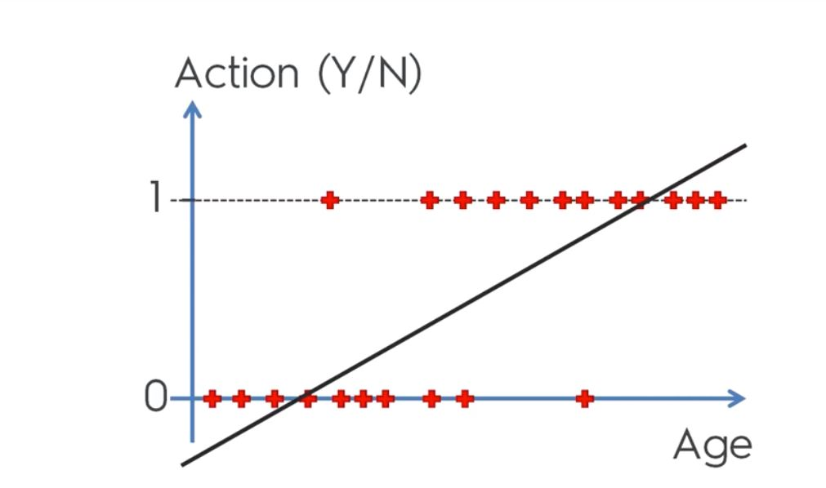
Logistic Regression

Slide 7
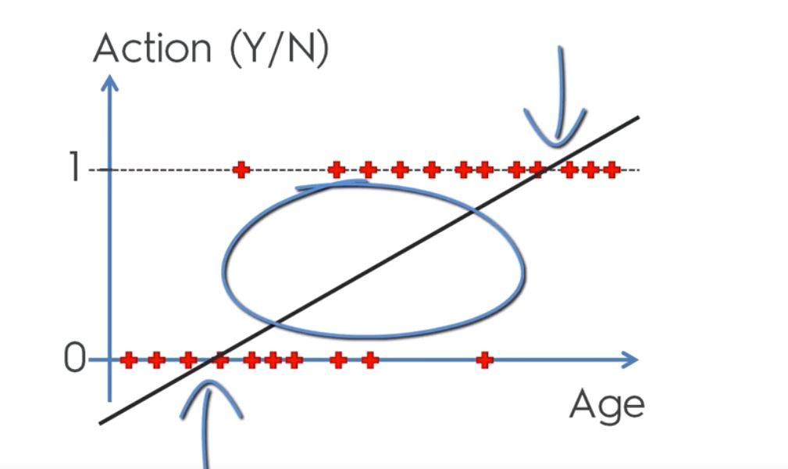
Logistic Regression

Slide 8
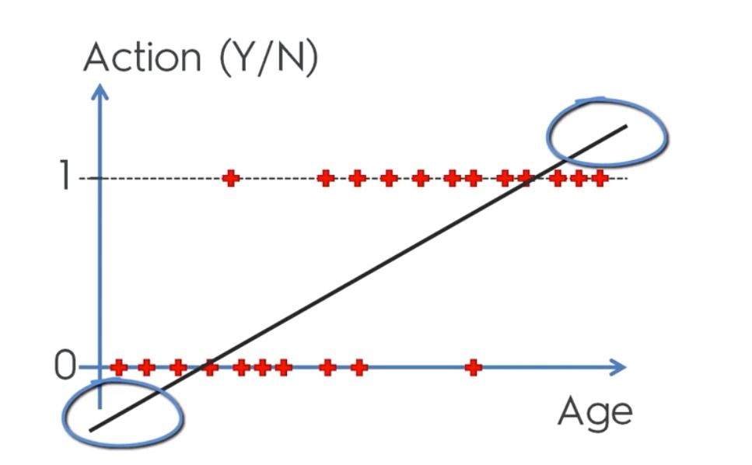
Logistic Regression

Slide 9
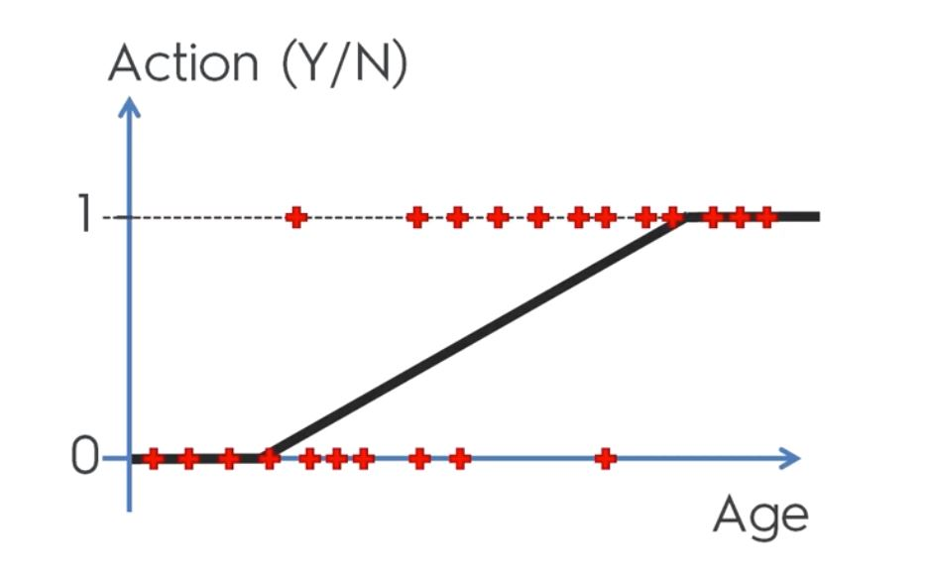
Logistic Regression

Slide 10
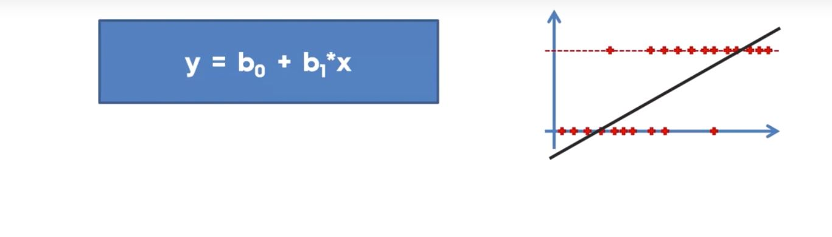
Logistic Regression

Slide 11
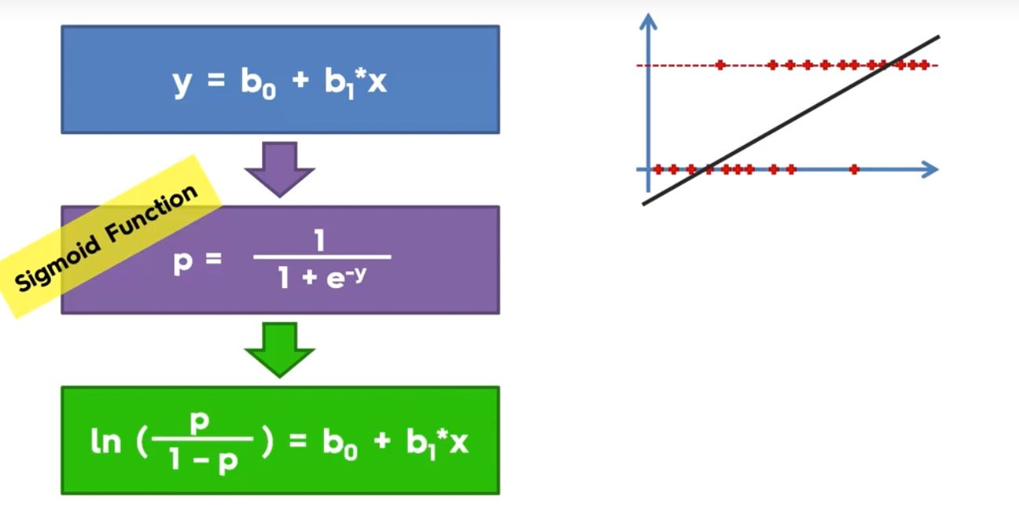
Logistic Regression

Slide 12
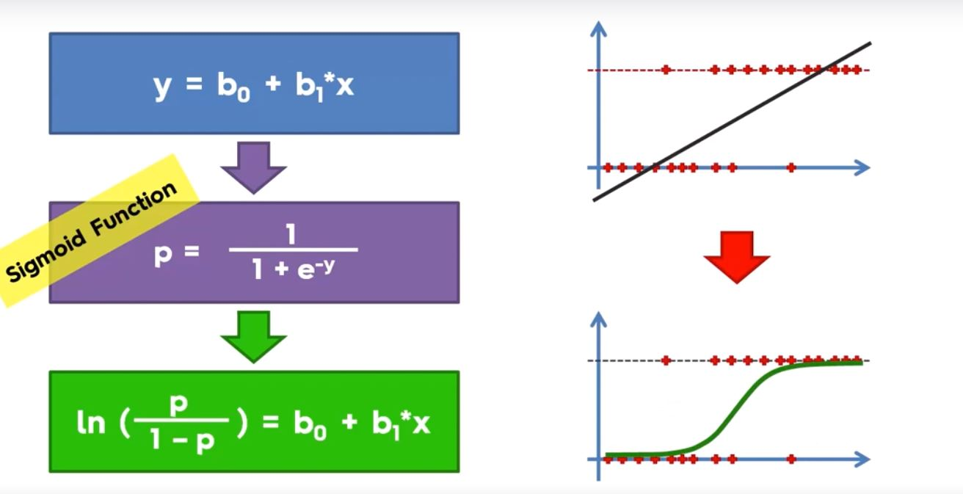
Logistic Regression

Slide 13
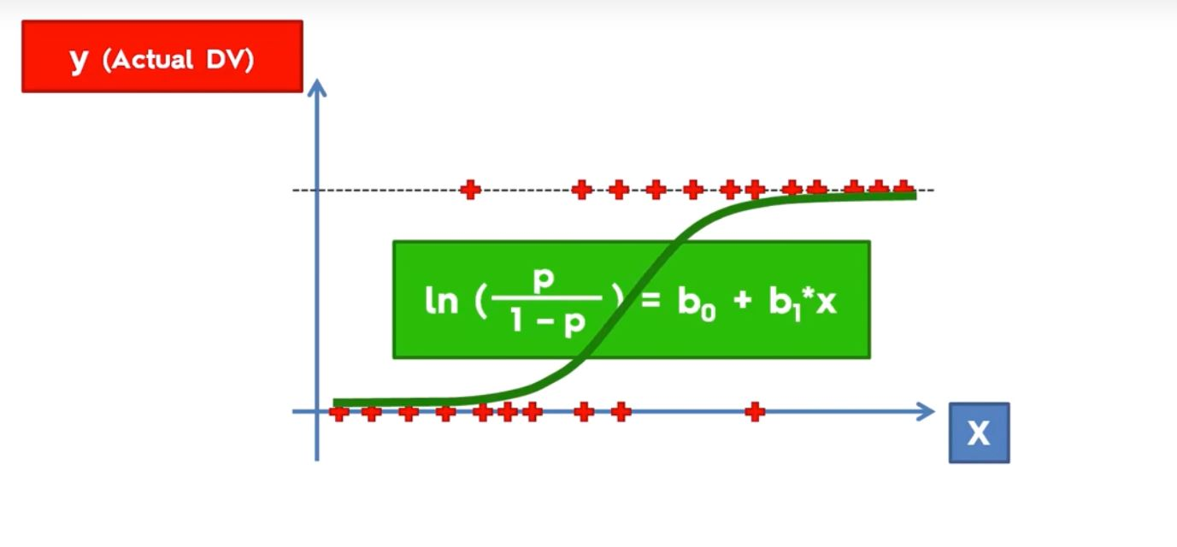
Logistic Regression

Slide 14
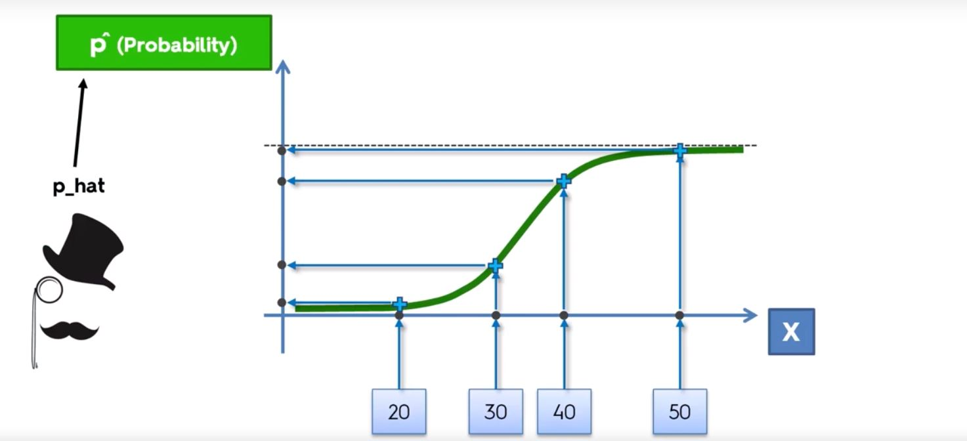
Logistic Regression

Slide 15
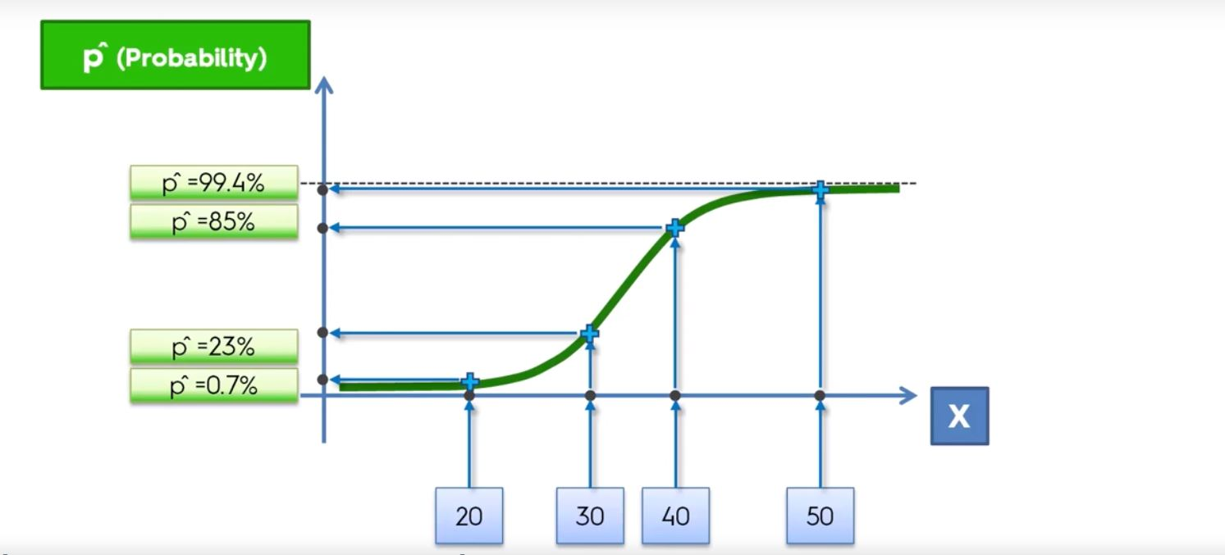
Logistic Regression

Slide 16
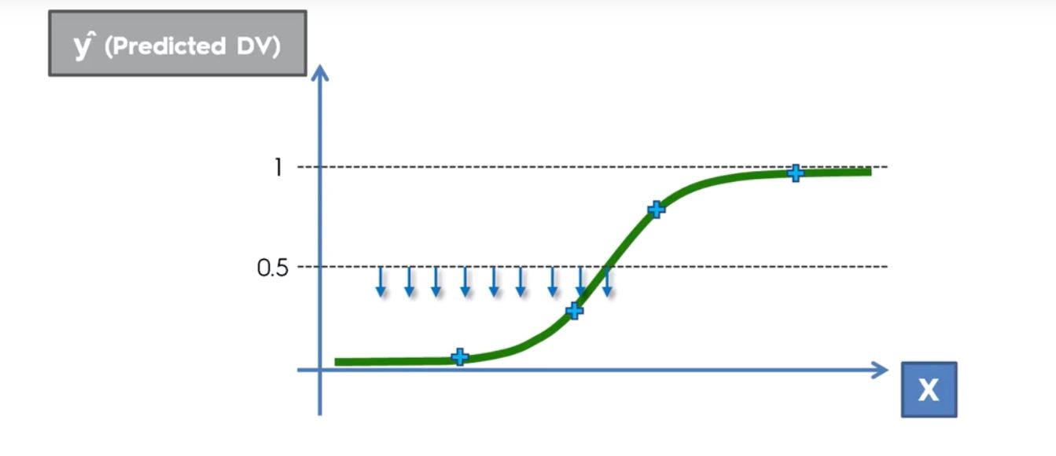
Logistic Regression

Slide 17
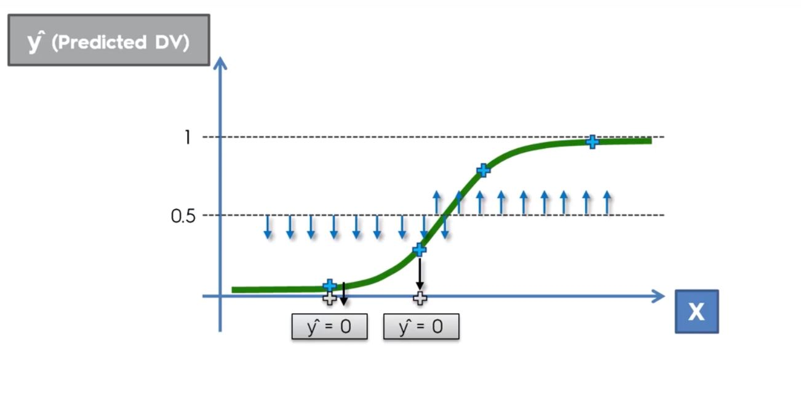
Logistic Regression

